Slide 1

Scraping the Surface of Beauty
EDA of Nykaa Products

Slide 2
About me
Name: M.V. Siva Teja
Degree: B.Tech (CSE)
College: Raghu Engineering College
Hello, my name is Siva Teja Mindaguditi. I am a final-year B.Tech student in the Computer Science and Engineering department at Raghu Engineering College. I have a strong interest in programming and data science, and I am currently enhancing my skills through a training program at Innomatics Research Labs. My technical skill set includes Python, SQL, Data Analysis, Web Scraping, Pandas, NumPy, Matplotlib, and Seaborn. I’m also comfortable using GitHub and working on real-world datasets. I am a quick learner, passionate about solving data-driven problems, and eager to contribute to dynamic and innovative projects.

Slide 3
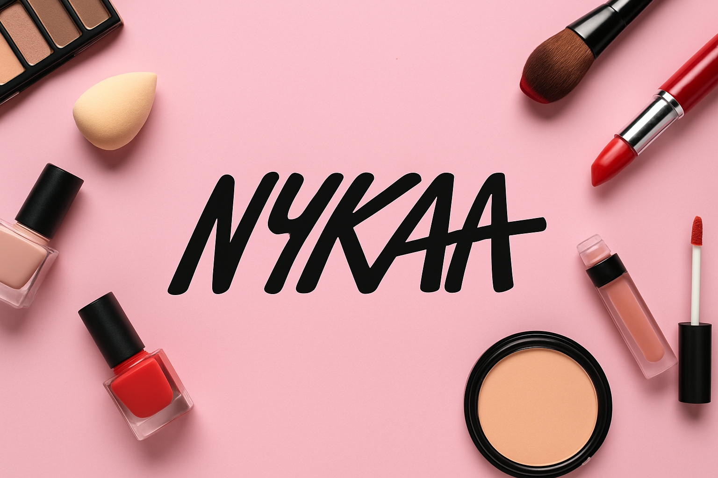
CaseStudy:
This case study focuses on analyzing beauty products listed on the Nykaa website by collecting data through web scraping techniques. The objective is to extract key product attributes such as brand name, price, ratings, and category, and perform Exploratory Data Analysis (EDA) to identify patterns, pricing trends, and product popularity across different segments. The study provides data-driven insights that can be valuable for both consumers and businesses to understand the beauty market landscape better.

Slide 4
Data Acquisition Using Web Scraping:
Data was extracted from the Nykaa website using web scraping techniques.
Python and BeautifulSoup library were used to parse HTML content.
Scraped key product attributes such as:
Product_Name
Original Price
Offer Price
Discount
Reviews
Offer
Used requests library to fetch HTML pages.
Handled pagination to collect data from multiple pages.
Extracted over 200+ product entries from different beauty categories.
Stored scraped data in a structured Pandas DataFrame for analysis.

Slide 5
Creating the DataFrame
Collected raw data was organized into lists for each attribute (brand, name, price, etc.).
Used Pandas library to create a structured DataFrame.
Previewed the DataFrame using df.head() for initial inspection.
Exporting to CSV
Final DataFrame was exported using to_csv() function.
File saved as "nykaa_beauty_products.csv" for further analysis.

Slide 6
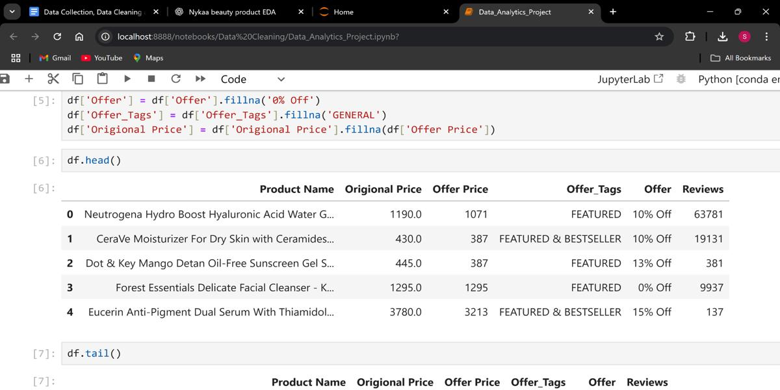
Data-Cleaning:
Checked for and removed any duplicate entries to ensure data uniqueness.
Handled missing values using dropna() to maintain data quality.
Filtered out irrelevant or incomplete product listings.
Reset the DataFrame index after cleaning for consistency.
Verified the shape and data types after cleaning using df.info() and df.shape.

Slide 7
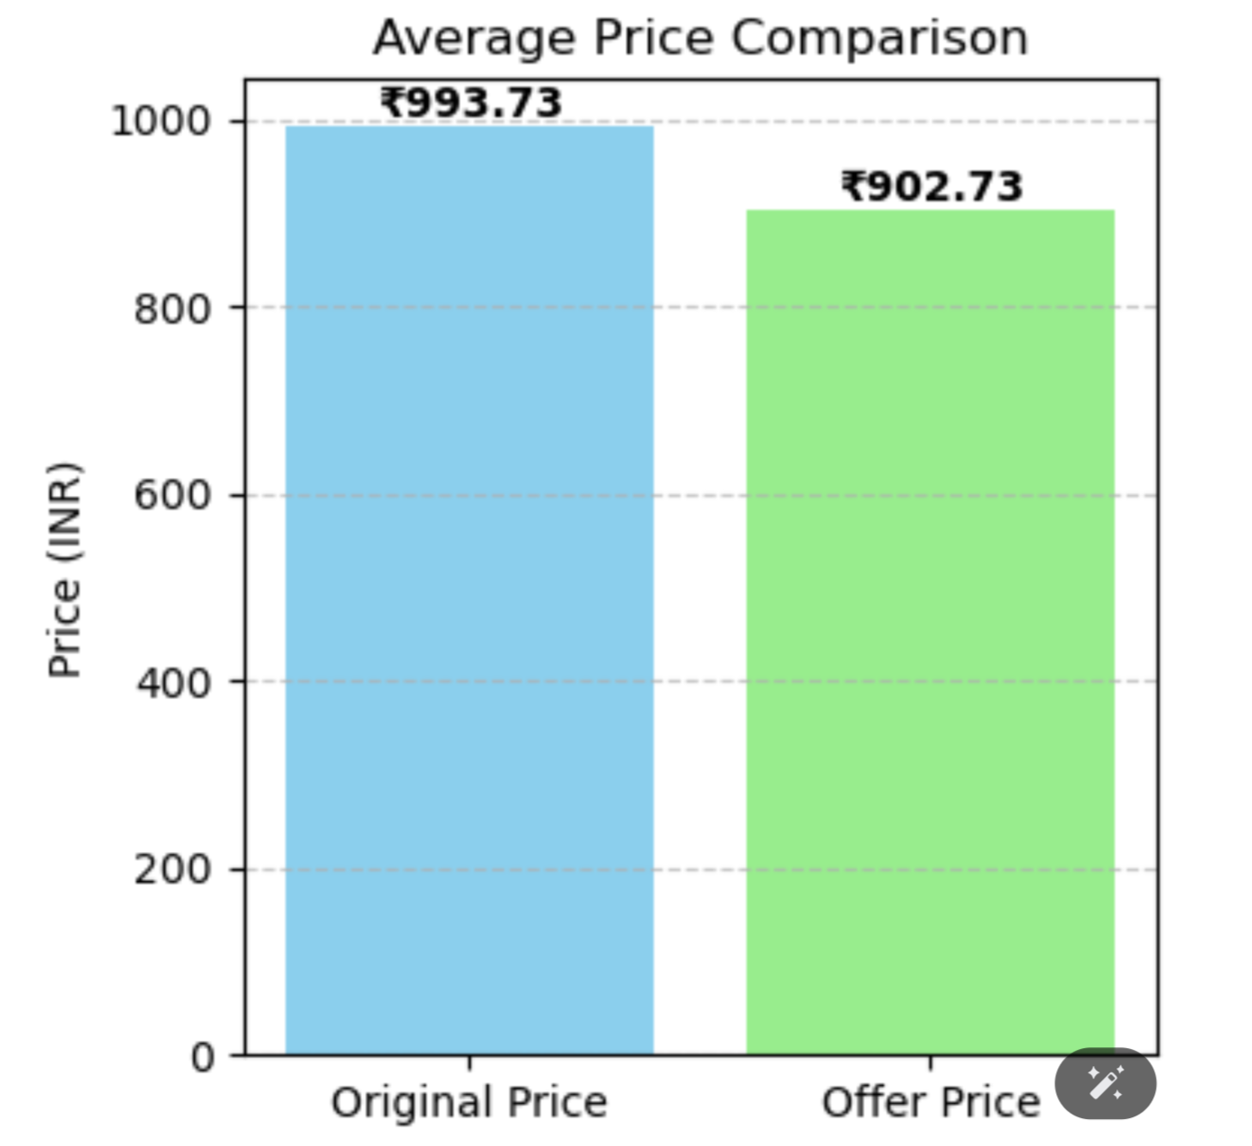
VISUALIZATION and INSIGHTS
Pricing Trends:
Insights from Average Price Comparison
Average Original Price: ₹993.73
Average Offer Price: ₹902.73
Average Discount: ₹91 per product
The average discount offered on Nykaa products is approximately 9.2%, indicating moderate price reductions.
This reflects a strong marketing strategy to attract price-sensitive customers without heavily compromising profit margins.
The consistency in price drop shows potential for seasonal analysis or identifying best times to purchase.

Slide 8
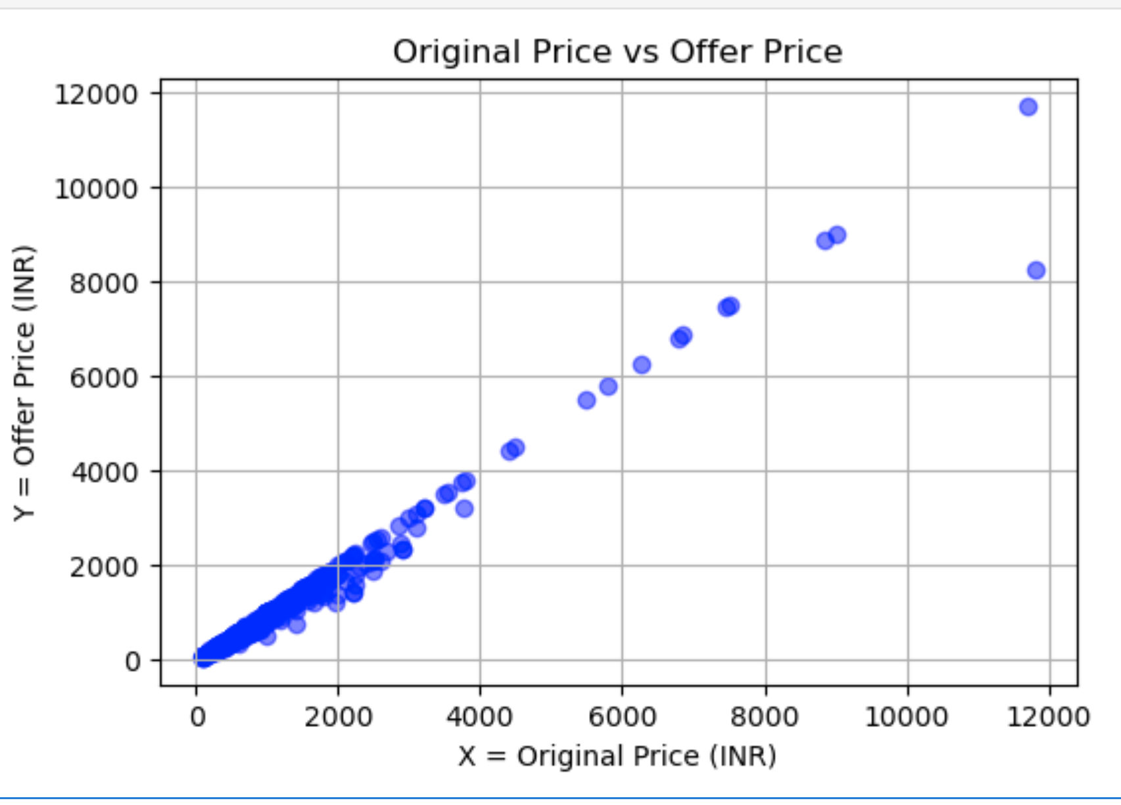
Original Price vs Offer Price
Strong positive correlation: As original price increases, offer price also increases, showing a strong linear relationship.
Most products are discounted: Majority of points lie below the y = x line, indicating offer price is lower than original price.
High density around mid-range prices: Most products are priced between ₹500–₹3000, targeting mass-market consumers.
Outliers exist: A few high-priced luxury products appear far from the main cluster
Few products have equal prices: Some products lie near the y = x line, showing no discounts applied.

Slide 9
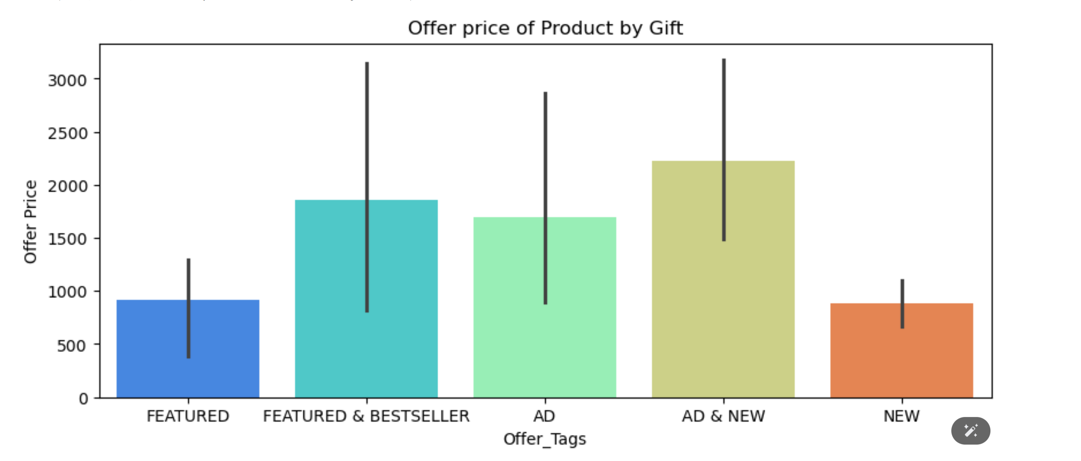
Offer Price by Gift Tag
Products tagged as "AD & NEW" have the highest average offer price, suggesting premium new launches.
The error bars (standard deviation) indicate price variability is highest for AD-based tags, reflecting a mix of both budget and premium products.
"FEATURED & BESTSELLER" and "AD" products also command higher prices, indicating high popularity or advertisement boost.
Surprisingly, "FEATURED" and "NEW" alone have lower average offer prices, suggesting they may be more competitively priced to attract buyers.

Slide 10
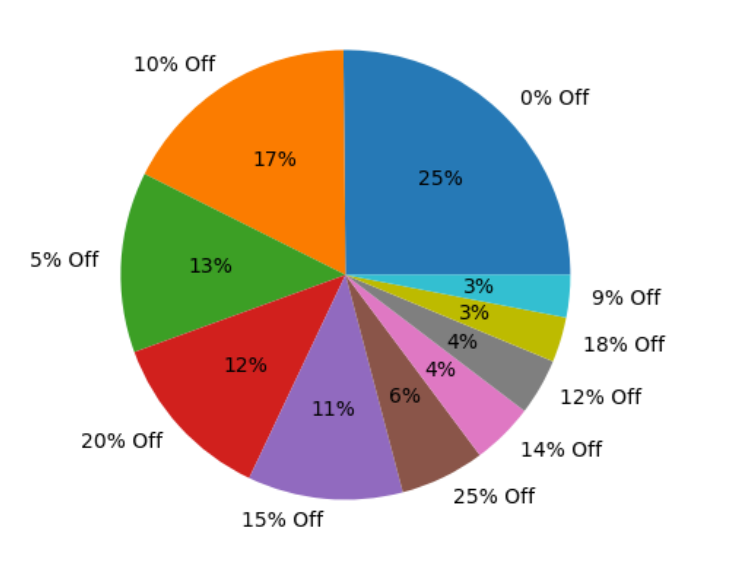
Discount Distribution (Pie Chart)
25% of products have 0% discount, meaning a significant number are sold at full price, possibly indicating premium brands or exclusives.
The most common discount is 10% (17%), followed by 5% (13%), and 20% (12%) – suggesting small to moderate discounts dominate the platform.
Only a small fraction (<5%) of products receive very high discounts (≥30%).
Indicates that Nykaa follows a modest discount strategy, preserving brand value while still offering some deals.

Slide 11
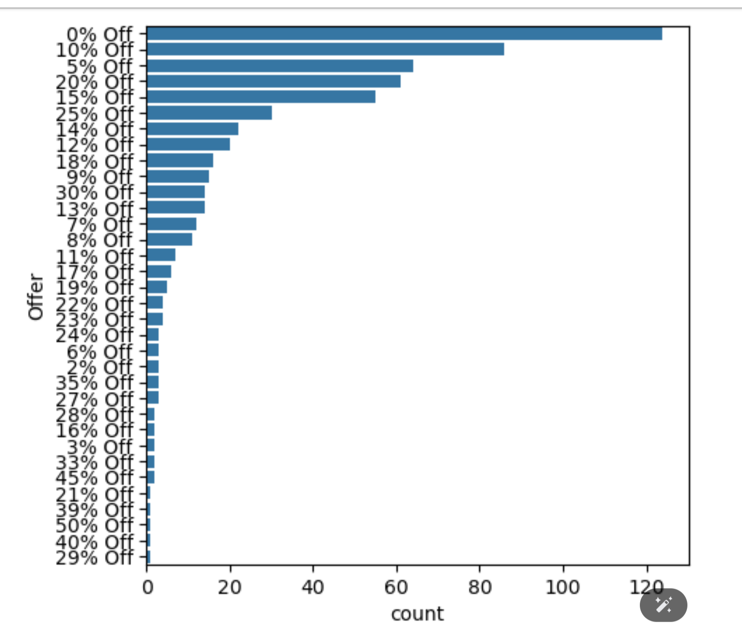
Product Count by Discount
0% discount dominates with ~120 products, confirming the earlier insight from the pie chart.
Discounts of 10%, 5%, 20%, and 15% follow in popularity – showing that most products are priced attractively, not excessively discounted.
Discounts beyond 25% are rare, and 50% Off is extremely rare, likely for clearance or less popular items.
This graph also helps identify which discount brackets are used most frequently by sellers on Nykaa – valuable for marketing or pricing strategy.

Slide 12
Conclusion:
The analysis reveals a strong positive correlation between original and offer prices, indicating consistent discounting patterns.
Majority of products are offered at discounted rates, especially in the ₹500–₹3000 range, catering to budget-conscious consumers.
Nykaa likely offers value-based pricing where discounts maintain product pricing tiers while offering perceived savings.
The presence of outliers shows that Nykaa also targets the premium market segment with higher-priced products.
The pricing strategy reflects a balanced approach, offering value across different price segments while encouraging purchases through discounts.
Overall, Nykaa’s pricing data shows strategic discounting and product positioning tailored to diverse customer segments.

Slide 13

THANK YOU

